Slide 1


OSI MODEL
1

Slide 2
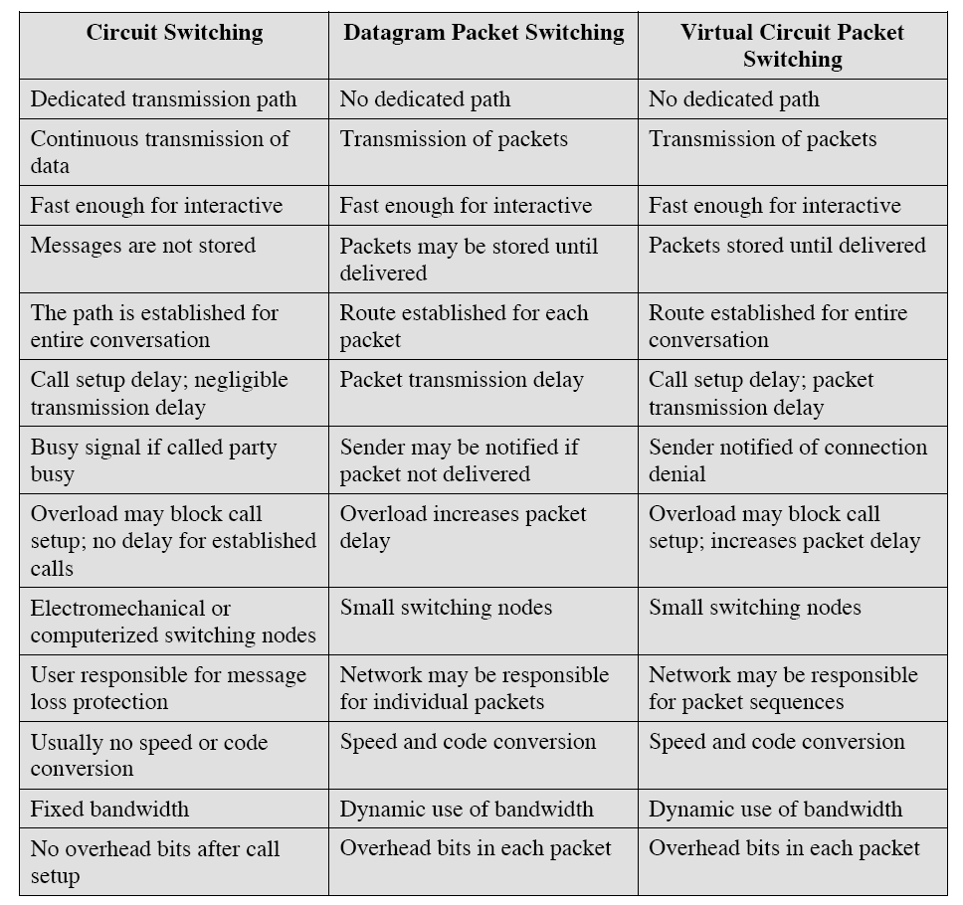

Slide 5
Introduction
■
Open Systems Interconnection Basic Reference Model (OSI
Reference Model or OSI Model) is an abstract description for
layered communications and computer network protocol design. It
was developed as part of the Open Systems Interconnection
(OSI) initiative. In its most basic form, it divides network
architecture into seven layers which, from top to bottom, are the
Application, Presentation, Session, Transport, Network, Data-Link,
and Physical Layers. It is therefore often referred to as the OSI
Seven Layer Model.
2

Slide 6








































OSI
OSI Model's
Model's 7
7 Layers
Layers
APPLICATION
Application to Application
APPLICATION
HIGHER LAYER
HIGHER LAYER
PRESENTATION
Application to Application
PRESENTATION
SESSION
Application to Application
SESSION
TRANSPORT
Process to Process
TRANSPORT
MIDDLE LAYER
MIDDLE LAYER
NETWORK
Source to Destination
NETWORK
Router
Source to Destination
DATA LINK
Hop to Hop
Switch
DATA LINK
LOWER LAYER
Hop to Hop
LOWER LAYER
Hub and Repeater
PHYSICAL
PHYSICAL
Physical Medium
3

Slide 7
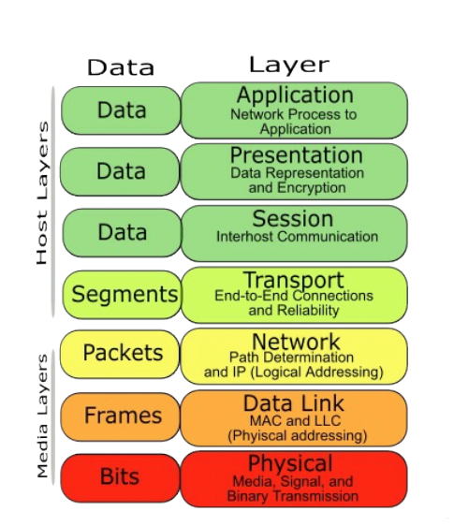
Host
Host and Media Layer
and Media Layer
4

Slide 8






Data, Protocol
Data, Protocol & Activities
& Activities
OSI Layers
TCP/IP Suit
Activities
Application
Application
To allow access to network resources
Telnet, FTP, SMTP, HTTP, DNS, SNMP, Specific address etc…
Presentation
Presentation
To Translate, encrypt, and compress
data
Session
Session
To establish, manage, and terminate
session
Transport
Transport
To Provide reliable process-to-process
Message delivery and error recovery
SCTP, TCP, UDP, Sockets and Ports address
Network
Network
To move packets from source to
destination; to provide internetworking
IP, ARP/RARP, ICMP, IGMP, Logical address
Data Link
Data Link
To organize bits into frames; to provide
Hop-to-hop delivery
IEEE 802 Standards, TR, FDDI, PPP, Physical address
Physical
Physical
To Transmit bits over a medium; to provide
Mechanical and electrical specifications
Medium, Coax, Fiber, 10base, Wireless
5

Slide 9












Physical Layer
From data link layer
To data link layer
Physical layer
110
10101000000010111
110
10101000000010111
Physical layer
Transmission medium
■
One of the major function of the physical layer is to move data in the form of electromagnetic signals
across a transmission medium.
Its responsible for movements of individual bits from one hop (Node) to next.
Both data and the signals can be either analog or digital.
Transmission media work by conducting energy along a physical path which can be wired or wireless
■
■
■
■
Concerned:
❑
Physical characteristics of interface and medium (Transmission medium)
Representation of bits (stream of bits (0s or 1s) with no interpretation and encoded into signals)
Data rate (duration of a bit, which is how long it last)
Synchronization of bits (sender and receivers clock must be synchronized)
Line configuration (Point-to-Point, Point-to-Multipoint)
Physical topology
Transmission mode (Simplex, half duplex, full duplex)
❑
❑
❑
❑
❑
❑
6

Slide 10





Data Link Layer (Host to Host)
From network layer
To network layer
Data link layer
H2
Data
T2
H2
Data
T2
Data link layer
To physical layer
From physical layer
■
Data link layer is responsible for moving frames from one hop (Node) to the next.
■
Concerned:
❑
Framing (stream of bits into manageable data units)
Physical addressing (MAC Address)
Flow Control (mechanism for overwhelming the receiver)
Error Control (trailer, retransmission)
Access Control (defining master device in the same link)
❑
❑
❑
❑
7

Slide 11



Network Layer (Source to Destination)
From transport layer
To transport layer
Network layer
H3
Data
Packet
H3
Data
Packet
Network layer
To data link layer
From data link layer
■
The network layer is responsible for the delivery of individual packets from the source
host to the destination host.
■
Concerned:
❑
Logical addressing (IP Address)
Routing (Source to destination transmission between networks)
❑
8

Slide 12

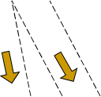
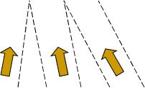






Transport Layer (Process to Process)
From session layer
From session layer
Transport layer
H4
Data
H4
Data
H4
Data
H4
Data
H4
Data
H4
Data
Transport layer
Segments
Segments
To network layer
From network layer
■
The transport layer is responsible for the delivery of a message from one process to
another
■
Concerned:
❑
Service-point addressing (Port address)
Segmentation and reassembly (Sequence number)
Connection control (Connectionless or connection oriented)
Flow control (end to end)
Error Control (Process to Process)
❑
❑
❑
❑
9

Slide 13






Session Layer (Dialog initiation)
From Presentation layer
To Presentation layer
Session layer
H5
Data
Data
Data
H5
Data
Data
Data
Session layer
Syn
Syn
Syn
Syn
Syn
Syn
To transport layer
From transport layer
■
The session layer is responsible for dialog control and synchronization
■
Concerned:
❑
Dialog Control (Half Duplex/Full duplex)
Synchronization (Synchronization points, process inline within same page)
❑
10

Slide 14
Presentation Layer (dependency)
From application layer
To application layer
presentation layer
H6
Data
H6
Data
presentation layer
To session layer
From session layer
■
The presentation layer is responsible for translation, compression and encryption
■
Concerned:
❑
Translation (interoperability between different encoding system)
Encryption (Privacy schemes)
Compression (data compression)
❑
❑
11

Slide 15












Application Layer (user level service)
USER
USER
(Human or Program)
(Human or Program)
X.500
FTAM
X.400
X.500
FTAM
X.400
Application layer
Application layer
H7
Data
Message
H7
Data
Message
To presentation layer
From presentation layer
■
The application layer is responsible for providing services to the user.
■
Concerned:
❑
Network virtual terminal (Software)
File transfer, access and management
Mail services
Directory services (access to distributed database sources for global information about various objects
❑
❑
❑
and services)
12

